Slide 1

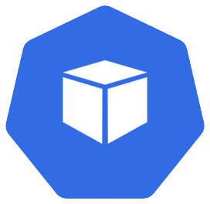
Deploying The App Part 1 – Target State
Azure
Kubernetes
deployment
deployment
data-api
mongodb
pod
pod
data-api-{random-string}
mongodb-{random-string}

Slide 2
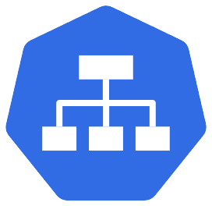




Basic Networking – Target State
Azure
Kubernetes
Service (ClusterIP)
pods
deployment
database
mongodb
port:27017
MongoDB connection/traffic
pods
Service (LoadBalancer)
Load Balancer
deployment
port:80
Public IP for
data-api
HTTP traffic from internet
data-api
data-api
port:4000

Slide 3
Adding The Frontend – Target State
Azure
Kubernetes
Service (LoadBalancer)
pod
deployment
port:80
mongodb
Load
Balancer
frontend
port:3000
frontend
Public IP for
frontend
deployment
HTTP traffic from internet
data-api
deployment
pods
port:
27017
Service
Public IP for
data-api
port:80
Service (LoadBalancer)
data-api
port:4000
database
MongoDB connection/traffic

Slide 4


Final Application State
Azure
Kubernetes
serviceName:frontend
service
pod
port:80
Load
Balancer
service
nginx
ingress
frontend
port:3000
data-api
Public IP for
ingress
HTTP traffic from internet
ingress controller
port:4000
pods
port:80
serviceName:data-api
service
MongoDB traffic
service
port:
27017
secret
pod
mongo-creds
database
mongodb

Slide 5


Typical Kubernetes Ingress Scenario
Kubernetes
Route: /app
Target: service1
service 1
HTTPS
Route: /api
Target: service2
TLS
Clients / Users
Public IP
Load
Balancer
HTTP
service 2
ingress controller
Route: /tokens
Target: service3
service 3

Slide 6
Bare metal with K3s

Slide 7
Deploying The App Part 1 – Target State
Azure
Virtual machine
Kubernetes
deployment
deployment
data-api
mongodb
pod
pod
data-api-{random-string}
mongodb-{random-string}

Slide 8



StatefulSet w/ localStorage
Azure
Virtual machine
Kubernetes
Presistent
Volume
StatefulSet
mongodb
persistentvolume/{random-string}
Local
Storage
Presistent
Volume
Claim
pod
persistentvolumeclaim/ mongo-data-mongodb-0
mongodb-0

Slide 9
Basic Networking – Target State
Azure
Virtual machine
Kubernetes
Service (ClusterIP)
pods
deployment
database
mongodb
port:27017
MongoDB connection/traffic
pods
data-api
deployment
port:30036
Public IP for
VM
HTTP traffic from internet
Service (nodePort)
data-api
port:4000

Slide 10
Adding The Frontend – Target State
Azure
Virtual machine
Kubernetes
Service (NodePort)
pod
deployment
port:30037
mongodb
frontend
port:3000
frontend
deployment
Public IP for
VM
HTTP traffic from internet
data-api
deployment
pods
port:
27017
Service
port:30036
Service (NodePort)
data-api
port:4000
database
MongoDB connection/traffic

Slide 11
Final Application State
Azure
Virtual machine
Kubernetes
serviceName:frontend
service
pod
port:80
service
nginx
ingress
frontend
port:3000
data-api
Public IP for
VM
port:30036
ingress controller
port:4000
pods
port:80
serviceName:data-api
service
MongoDB traffic
service
port:
27017
secret
pod
mongo-creds
database
mongodb

Slide 12
Typical Kubernetes Ingress Scenario
Kubernetes
Route: /app
Target: service1
service 1
HTTPS
Route: /api
Target: service2
TLS
Clients / Users
Public IP
Load
Balancer
HTTP
service 2
ingress controller
Route: /tokens
Target: service3
service 3

